Slide 1


Spark Interview Questions Spark Session

Slide 2
What is Spark Session
Apache Spark2.0 onwards, Spark Session is the new entry point for Spark applications.
All the functionalities provided by Spark context are all available in Saprk Session.
Spark Session provides api(s) to work on Datasets and Dataframes.
Prior to Spark2.0 :::
Spark Context was the entry point for spark jobs.
RDD was one of the main APIs then, and it was created and manipulated using Spark Context.
For every other APIs, different contexts were required – For SQL, SQL Context was required.
For Streaming, Streaming Context was required.
For Hive, Hive Context was required.
All the APIs available in different contexts – Spark Context, SQL Context, Streaming Context, Hive Context are now available in SparkSession.

Slide 3
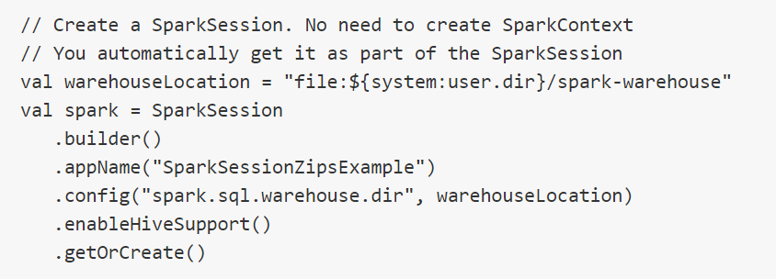
Spark Session with Scala

Slide 4
Thanks and do subscribe to my channel

